Slide 1
Admin Menu Redesign
Modern UX best practices for dealing with complex menus

Slide 2

Current Admin Menu
The Admin Menu is split into two main columns
The main modules and submenus are on the left column
Various admin-related reporting is in the right column
There is no search bar for quickly locating submenu options

Slide 3
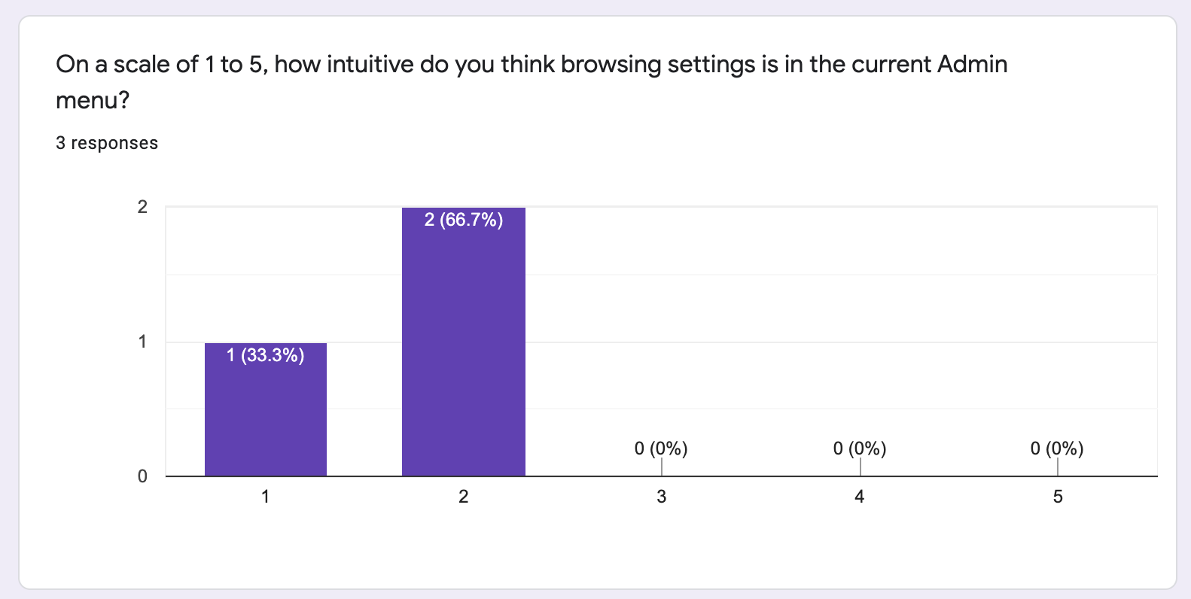
Current Admin Menu - User Feedback
Participants: 3 Range: 1 (Not intuitive at all) to 5 (Very intuitive)

Slide 4
Redesigned Admin Menu
The redesigned Admin Menu is now split into two main rows / sections
The main modules and submenus are in the upper section
The reporting is now in the bottom section
There is still no search bar, but it’s easier to view menu options without the need to scroll down the page

Slide 5
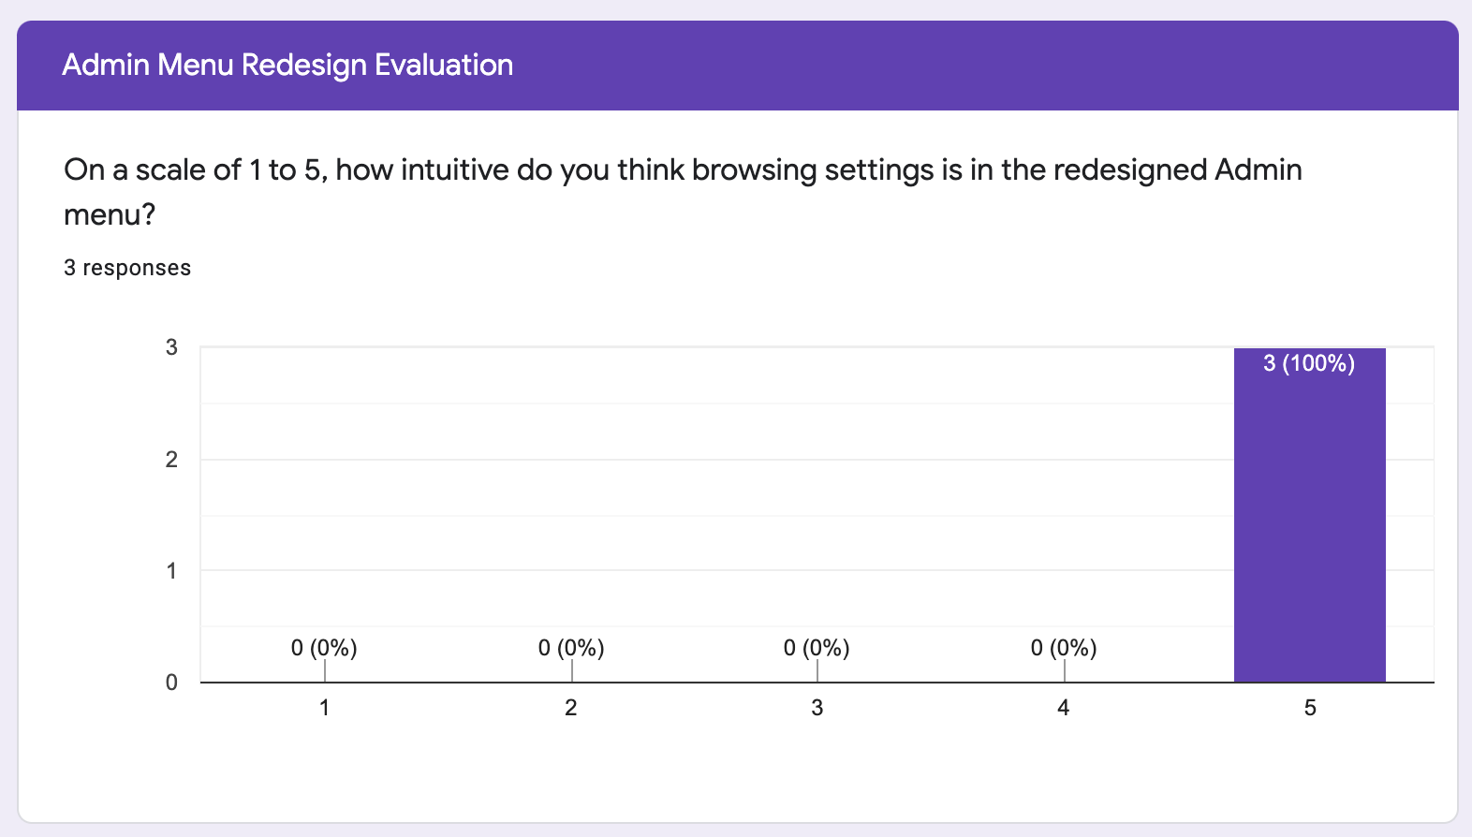
Redesigned Admin Menu - User Feedback
Participants: 3 Range: 1 (Not intuitive at all) to 5 (Very intuitive)

Slide 6
Current Admin Submenu
The Admin Submenu currently makes up about ⅔ of the page width
More than half of the settings are nested under ‘Additional Settings’
With the settings menu fully expanded, you need to scroll up and down to view all settings options

Slide 7
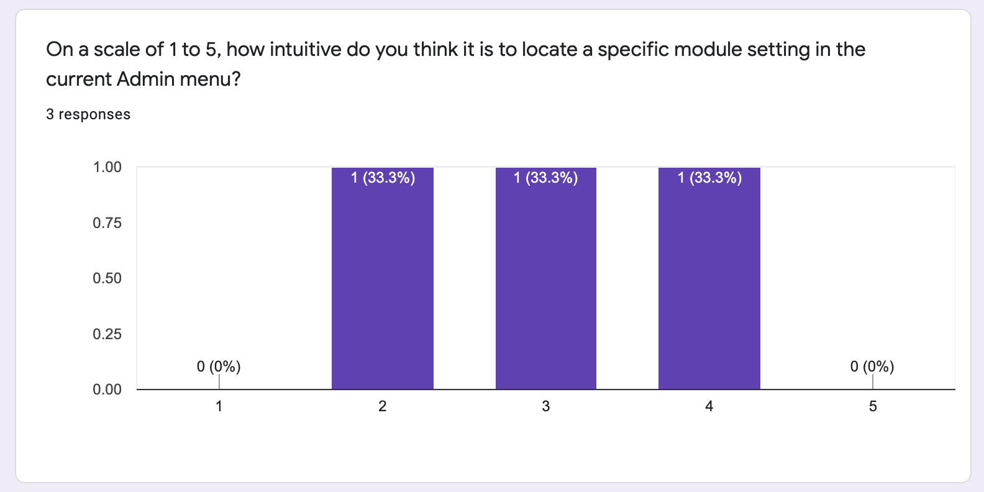
Current Admin Submenu - User Feedback
Participants: 3 Range: 1 (Not intuitive at all) to 5 (Very intuitive)

Slide 8
Redesigned Admin Submenu
The redesigned Admin Submenu makes up the full page width
All settings are visible, no additional settings are nested
With more space dedicated to view all settings, the left nav-bar for viewing other submenus has been removed

Slide 9
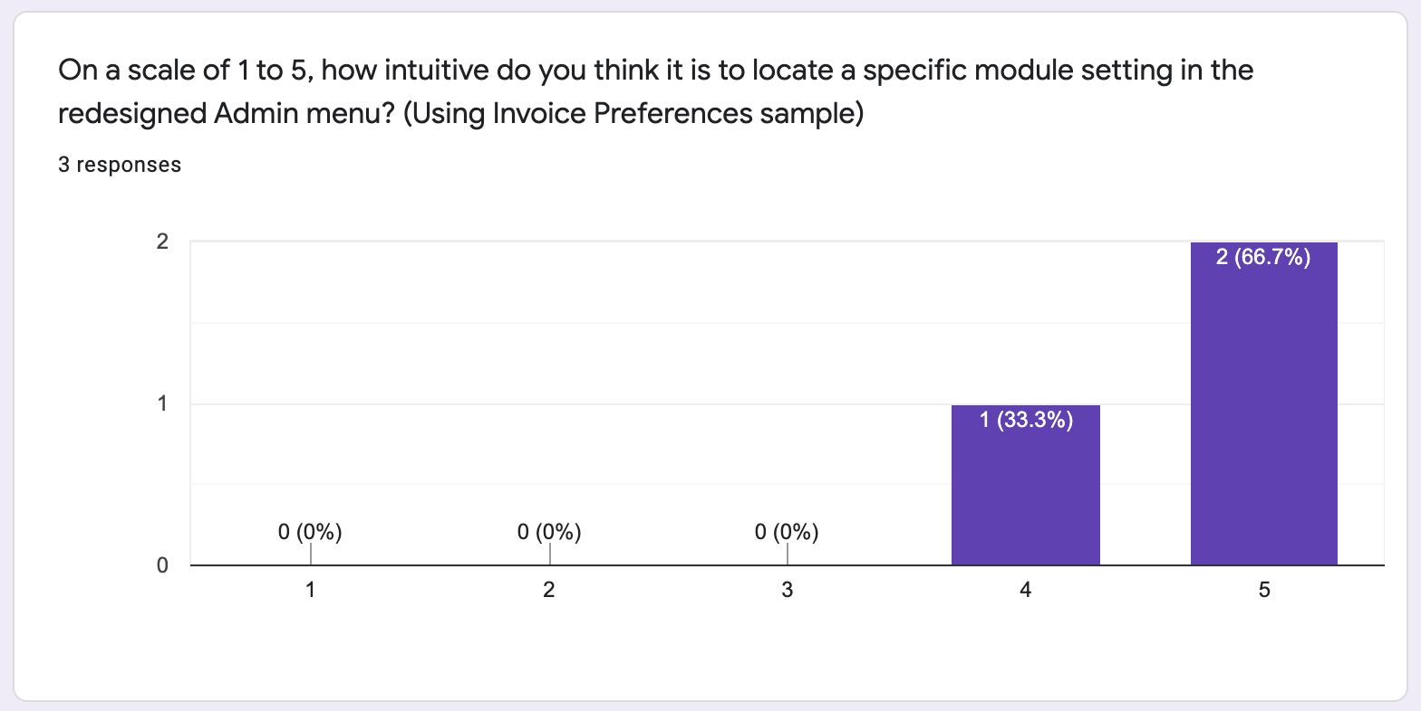
Redesigned Admin Submenu - User Feedback
Participants: 3 Range: 1 (Not intuitive at all) to 5 (Very intuitive)

Slide 10

Conclusion
Based on user feedback, the redesigned menu ranks more intuitive — success!
Ultimately, usability appears to increase when all options are presented to the user
Sacrifices were made in order to clear up space for better UX
If I were to iterate on this further, I would find a way to incorporate the submenu nav -bar on the Admin submenu page

